Slide 1
MINI PROJECT 0N
Video Share
Submitted To: Submitted by:
Miss. Sangeeta Singh Manaj Sarkar(1022310047)
Mohit Goyal(1022310050)
Rahul Negi(1022310067)
Rishi Kumar(1022310070)

Slide 2
content
Aim
Introduction
Home page
Modules
Categories
Search Module
User information
Registration Module
Login Module
Data Flow diagram
E-R diagram
System requirements
Technologies uses
Conclusion
Refrences

Slide 3
AIM
To create a blog where users can share videos and can also respond to others’ videos.

Slide 4
Introduction
The main objective of the project is to provide a platform where videos can be shared without any barriers for the purpose of knowledge and entertainment.
Gaining knowledge becomes easy if we find fun in it so we are trying to develop a site where the public can share knowledge and of course entertaining videos. This is an open video sharing site i.e. anyone can freely view, share and upload videos. This site is developed to display a wide variety of user-generated video content under the categories Tutorials, Music, Short Movies and Sports.

Slide 5
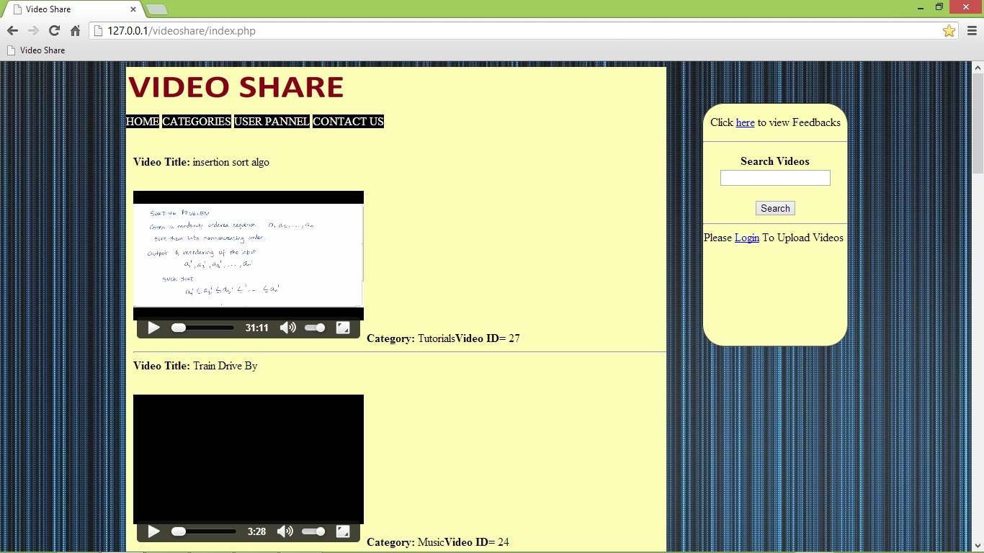
Home page

Slide 6
Modules
Categories
Search Module
User information
Registration Module
Login Module

Slide 7
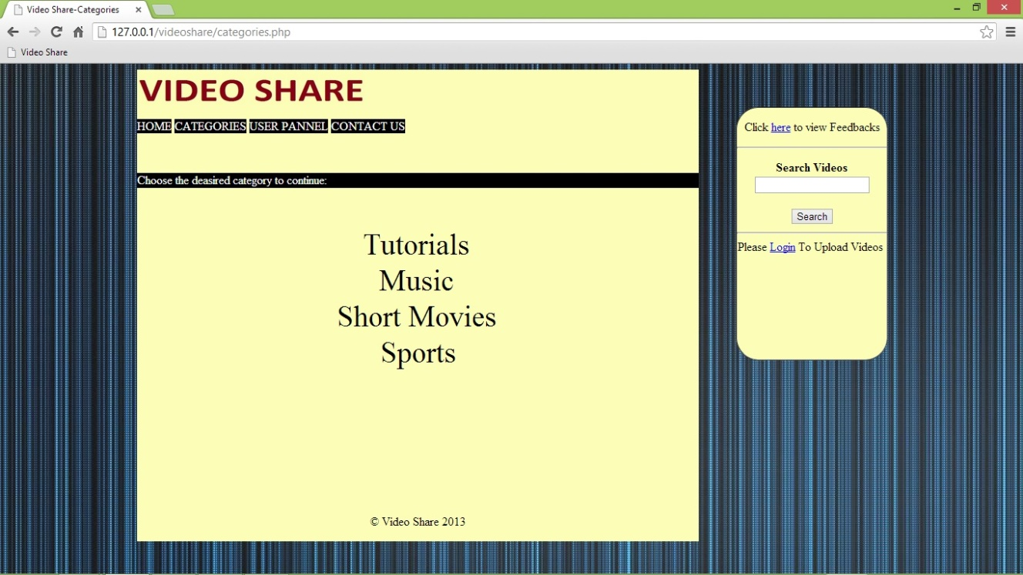
Categories Module
Tutorials
Music
Short Movies
Sports

Slide 8

Search module
Through this users can search videos as per their requirement.

Slide 9
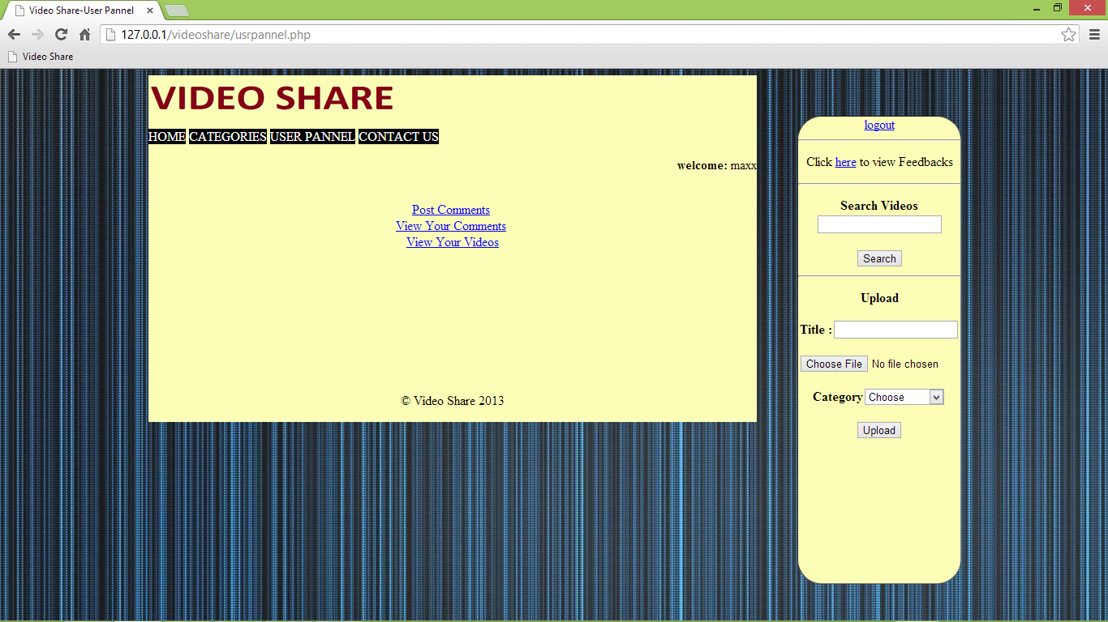
User information module
From here user can view their comments and videos
Can upload videos
Can respond to others’ videos

Slide 10
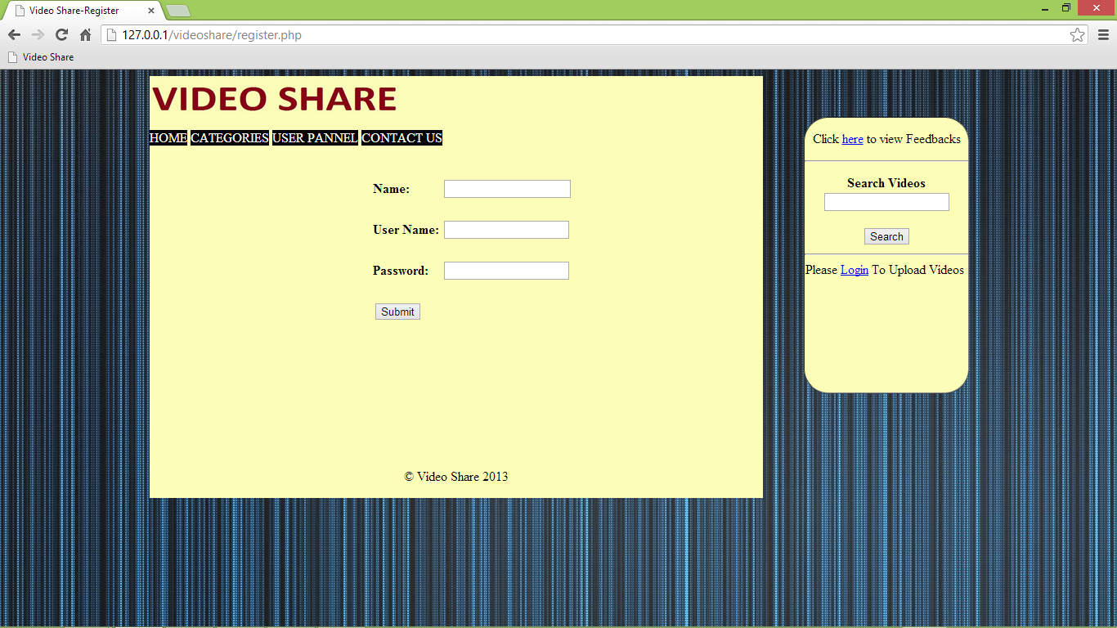
Registration module
From here user can register on videoshare.

Slide 11
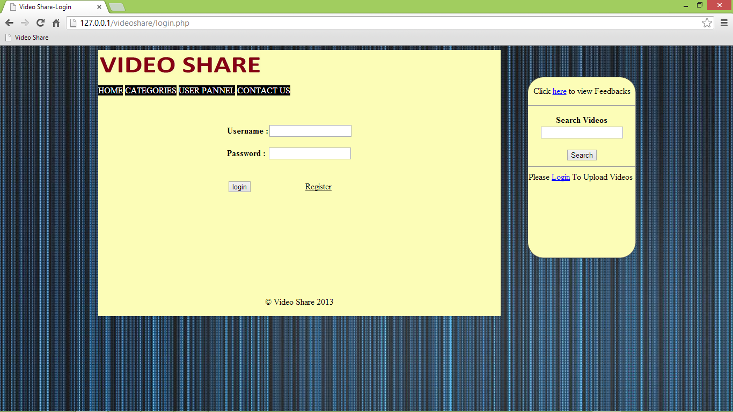
Login module
From here registered users can Login to his account

Slide 12
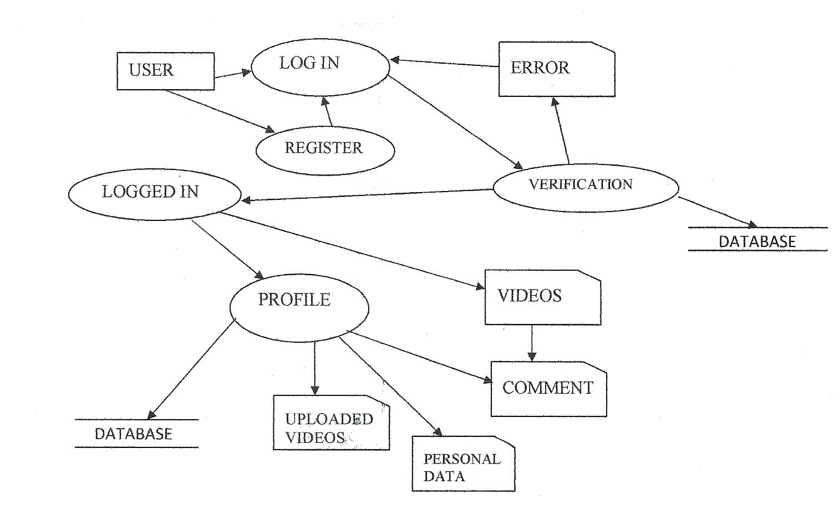
Data flow diagram

Slide 13
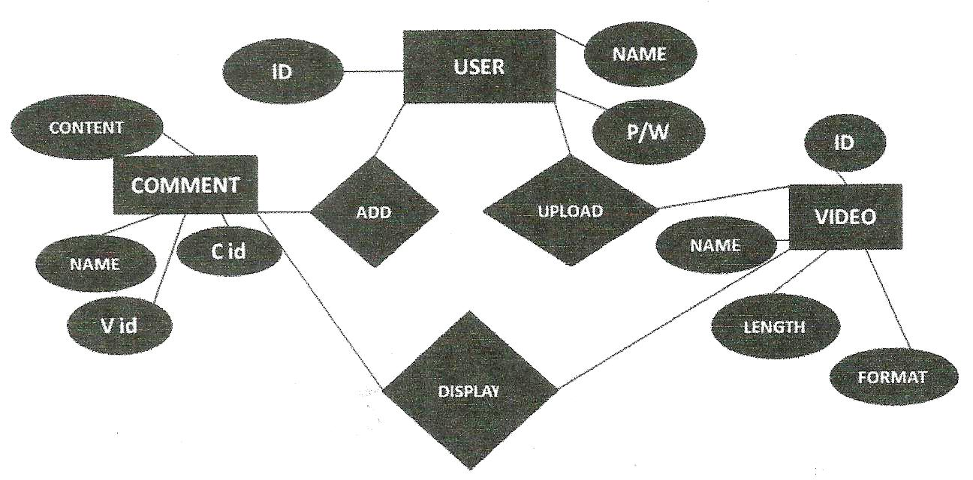
ER diagram

Slide 14
System requirements
RAM – 512MB
Free HDD space – 100MB
Working Internet Connection
HTML5 and CSS3 compatible Web Browser

Slide 15
Technologies used
Front end:
HTML as markup language
CSS as styling language
Back end:
PHP as programming language
SQL to manage database
Apache server as a offline server

Slide 16
conclusion
Computer has clearly got advantage over the manual system. The computerized system is more reliable, efficient, cheap and fast.
At the end of the project, we can say that computer plays a very crucial role in the sharing of data legally. As computer is used in every field so it provides comfort and suitability to everyone. Providing maximum facilities, information and comfort to the users is the main goal of this site.

Slide 17
refrences
www.w3schools.com
www.codecademy.com

Slide 18
Any Questions?

Slide 19
Thank You

